Slide 1
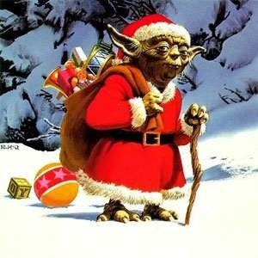
CELTIC RHYTHMS

Slide 2
RHYTHM 1

Slide 3
RHYTHM 2

Slide 4
RHYTHM 3

Slide 5
RHYTHM 4

